Slide 1
Foundations of ai philosophy
Satya Ajay

Slide 2
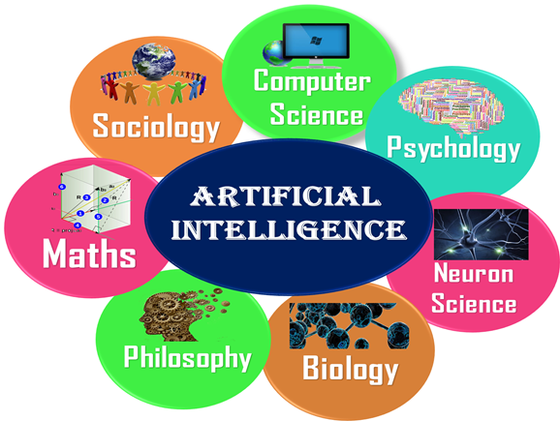
Introduction
Artificial Intelligence is not just a part of computer science even it's so vast and requires lots of other factors which can contribute to it. To create the AI first we should know that how intelligence is composed, so the Intelligence is an intangible part of our brain which is a combination of Reasoning, learning, problem-solving perception, language understanding, etc.
To achieve the above factors for a machine or software Artificial Intelligence requires the following discipline:
Mathematics
Biology
Psychology
Sociology
Computer Science
Neurons Study
Statistics

Slide 3

What is Philosophy ?
A belief (or system of beliefs) accepted as authoritative by some group or school
Any personal belief about how to live or how to deal with a situation
Quite literally, the term "philosophy" means, "love of wisdom." In a broad sense, philosophy is an activity people undertake when they seek to understand fundamental truths about themselves, the world in which they live, and their relationships to the world and to each other.
Types of Questions:
Is there a God?
What is truth?
What is a person? What makes a person
the same through time?

Slide 4

philosophical foundations of ai
The disciplines that contributed ideas, viewpoints, and techniques to AI. It is forced to concentrate on a small number of people, events, and ideas and to ignore others that also were important. I’ll explain and represent it through a series of questions
How does the mind arise from a physical brain?
Where does knowledge come from?
How does knowledge lead to action?
Can formal rules be used to draw valid
conclusions ?

Slide 5
philosophical foundations of ai
Aristotle (384-322 B.C.): was the first to formulate a precise set of laws governing the rational part of the mind.
Thomas Hobbes (1588-1679) proposed that reasoning was like numerical computation, that “ we add and subtract in our silent thoughts.”
Rene Descartes(1596-1650): Developed dualistic theory of mind and matter. Descartes attempted to demonstrate the existence of god and the distinction between the human soul and body. The empiricism movement, starting with Francis Bacon's (1561— 1626).
The confirmation theory of Carnap and Carl Hempel (1905-1997) attempted to analyze the acquisition of knowledge from experience.
Carmap’s book The Logical Structure of the World (1928) defined an explicit computational procedure for extracting knowledge from elementary experiences. It was probably the first theory of mind as a computational process.
The final element in the philosophical picture of the mind is the connection between knowledge and action. This question is vital to Al because intelligence requires action as well as reasoning.

Slide 6
THANK YOU
Satya Ajay
rsa914016@gmail.com
https://github.com/rsa914016

